Slide 1







Monitoring & Continuous Retraining in ML
Exploring effective strategies for model performance and reliability

Slide 2



Key Terms and Definitions for Monitoring Models
Drift Detection: Identifying changes in data patterns over time by using rolling error metrics.
Continuous Retraining: Regularly updating models to maintain accuracy.
Error Metrics: Measurements to evaluate model performance and effectiveness.
Canary Deployment: Gradually rolling out new models to monitor performance.

Slide 3



Key Terms to Know
Understanding the key terms and definitions.
Model Drift
Feature Skew
Canary Deployment
CI/CD
MAE / RMSE
Model performance worsens due to changing patterns
Mismatch between train-time and run-time features
Partial rollout of new model for safety testing
Automated build + test + deploy pipelines
Error metrics for evaluating predictions

Slide 4



Why Monitor Models?
🔁 Data shifts: new appliances, weather, policies
😞 Poor predictions → user distrust, wasted compute
🧠 Real Example: UK utility MAE doubled post-lockdown → retraining fixed in 48 h
Monitoring models is essential to ensure that they perform as expected in real-world situations. It involves tracking metrics and performance over time to identify any degradation in accuracy or unexpected behavior. Continuous monitoring helps in making informed decisions about retraining and maintaining model reliability, ultimately leading to better outcomes.
Effective monitoring enables proactive adjustments and improvements.

Slide 5


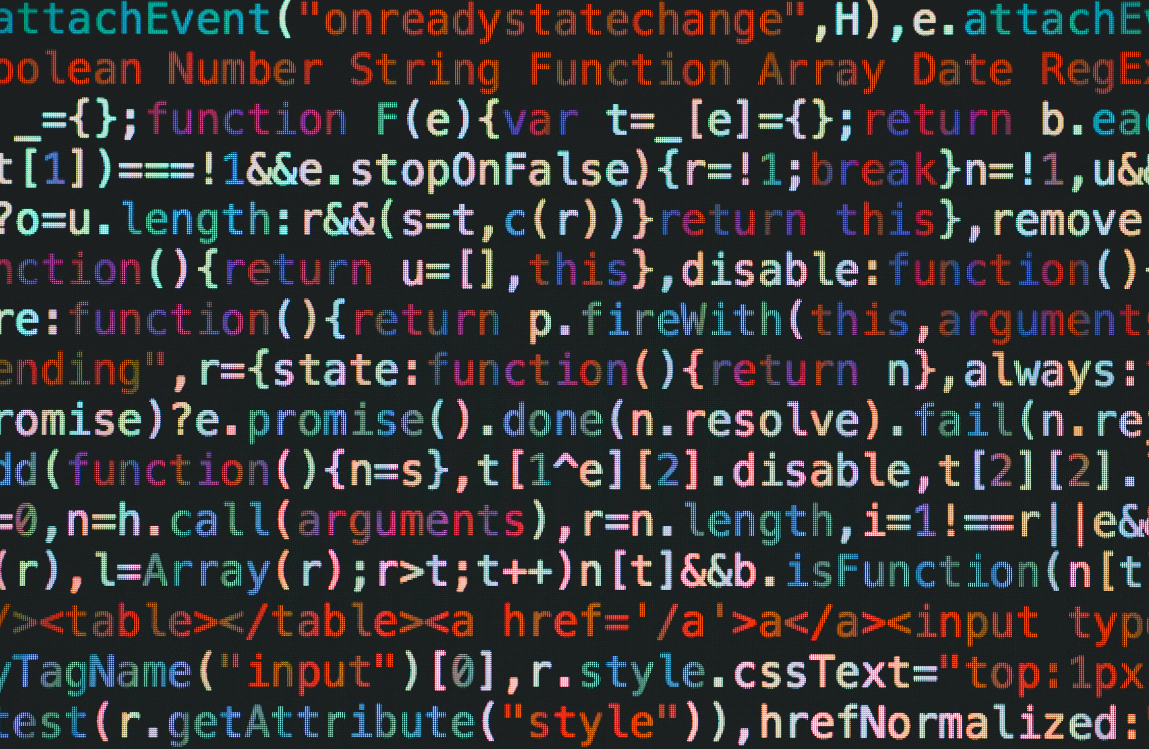
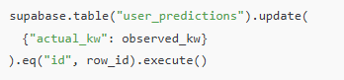

Logging Ground Truth with SQL and Python
Extend Table (SQL):
Update Later (Python):
In this section, we will explore how to effectively log ground truth using SQL and Python. Proper logging ensures that we have accurate data for model training and evaluation. Utilize SQL queries to extract relevant datasets, and employ Python scripts to automate data logging processes. By maintaining a robust logging mechanism, we can enhance model performance, track changes, and facilitate continuous improvement in our machine learning workflows.

Slide 6




Calculating Error Metrics
Store and track abs_err for use in drift detection
Enables rolling MAE visualizations
In machine learning, calculating error metrics is crucial for evaluating model performance. Common metrics include Mean Absolute Error (MAE), Mean Squared Error (MSE), and R-squared. Using Python, these metrics can be calculated easily with libraries like NumPy and scikit-learn. For instance, after predicting values, you can compare them against the ground truth to quantify how well your model is performing and identify areas for improvement.

Slide 7


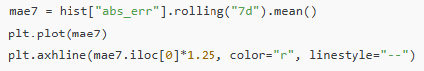
Drift Detection and Trigger Rule
Monitoring model performance is crucial for maintaining accuracy over time. Drift detection refers to identifying changes in data distribution that may impact model predictions. Implementing a trigger rule allows teams to take action when significant drift is detected. For instance, if the prediction accuracy drops below a certain threshold, it signals the need for retraining the model. This proactive approach ensures that models remain effective and relevant as new data emerges, ultimately leading to better decision-making and improved outcomes.
Drift Trigger Rule:
If 7-day MAE exceeds +25% baseline for 3+ days → retrain.

Slide 8

Setting Up GitHub Actions for Retraining
GitHub Actions automate workflows, making it easier to manage continuous integration and deployment for machine learning models. By utilizing these actions, teams can ensure that their models are retrained automatically when new data becomes available. This process enhances model performance and keeps predictions accurate over time, fostering a more reliable machine learning environment.
Automate your retraining workflows effectively.

Slide 9

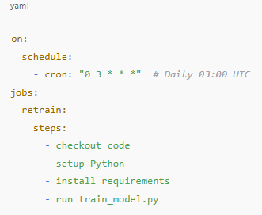
Setting Up GitHub Actions for Retraining
.github/workflows/retrain.yml
Automate your retraining workflows effectively.

Slide 10
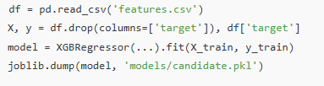
train_model.py Summary
🎯 Output:
Trained candidate model
Metrics file (e.g., RMSE)
Automate your retraining workflows effectively.

Slide 11
Promotion Logic for New Models
Understanding the threshold formula is essential for effective model promotion and ensuring improved performance metrics.
Threshold Formula Explained
Key Performance Indicators
Implementation Strategies
The threshold formula determines when a new model should be promoted based on performance metrics.
Monitoring KPIs helps in assessing whether a new model surpasses the existing one before deployment.
Utilizing this formula effectively ensures that only the best-performing models are brought into production.

Slide 12
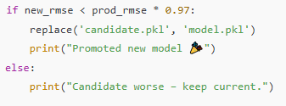
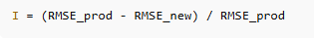
Promote If Better
Threshold Formula:
Automate your retraining workflows effectively.

Slide 13
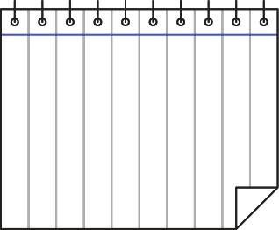


Summary of train_model.py
Model Training Process
Parameter Tuning
Model Evaluation
Saving the Model
The train_model.py script manages the entire process of training machine learning models. It includes loading data, preprocessing, selecting algorithms, and splitting datasets into training and validation sets to ensure optimal learning conditions.
Parameter tuning is crucial for achieving the best performance of machine learning models. The script employs techniques such as grid search and random search to find the ideal parameters that enhance model accuracy and efficiency.
After training, the model is evaluated using metrics like accuracy, precision, and recall. The script implements cross-validation to ensure that the model generalizes well on unseen data and avoids overfitting.
Once a model meets the performance criteria, the script saves it using joblib or pickle. This allows for easy deployment and integration into production environments, ensuring that the trained model can be reused effectively.

Slide 14




Key Concepts in Continuous Integration for Machine Learning
Integrating CI/CD ensures automated testing and model updates.
Status badges help visualize build health and deployment status.
Effective communication of status boosts team collaboration and confidence.
Consistent monitoring of models maintains performance over time.

Slide 15




Comparing Canary and Shadow Deployment Strategies
Canary deployment involves gradual rollout to a subset of users.
Both strategies aim to minimize risk during deployment.
Shadow deployment runs in parallel, gathering data without user impact.
This comparison highlights the strengths and weaknesses of both deployment strategies.

Slide 16
Key Insights from Monitoring & Continuous Retraining
Continuous retraining adapts models to changing data patterns.
Effective monitoring ensures models perform well over time.
Implementing deployment strategies enhances model reliability and uptime.
Error metrics provide crucial insights into model performance.

Slide 17
Thank You For Listening

